Slide 1
Unit 4
(Calculus for data science)

Slide 2
CALCULUS FOR DATA SCIENCE
Calculus is one of the most important mathematical foundations of data science. It deals with change and motion, helping us understand how quantities vary with respect to one another. In data science, calculus is used to optimize models, measure rates of change, and train machine learning algorithms.
Most data science algorithms, especially in machine learning and deep learning, rely heavily on calculus concepts such as derivatives, partial derivatives, gradients, and optimization techniques.
Types of Calculus Used in Data Science
1. Differential Calculus
Deals with rates of change and slopes of functions. Used to understand how a small change in input affects the output.
2. Integral Calculus
Deals with accumulation and area under curves. Used to compute total values, probabilities, and expectations.

Slide 3
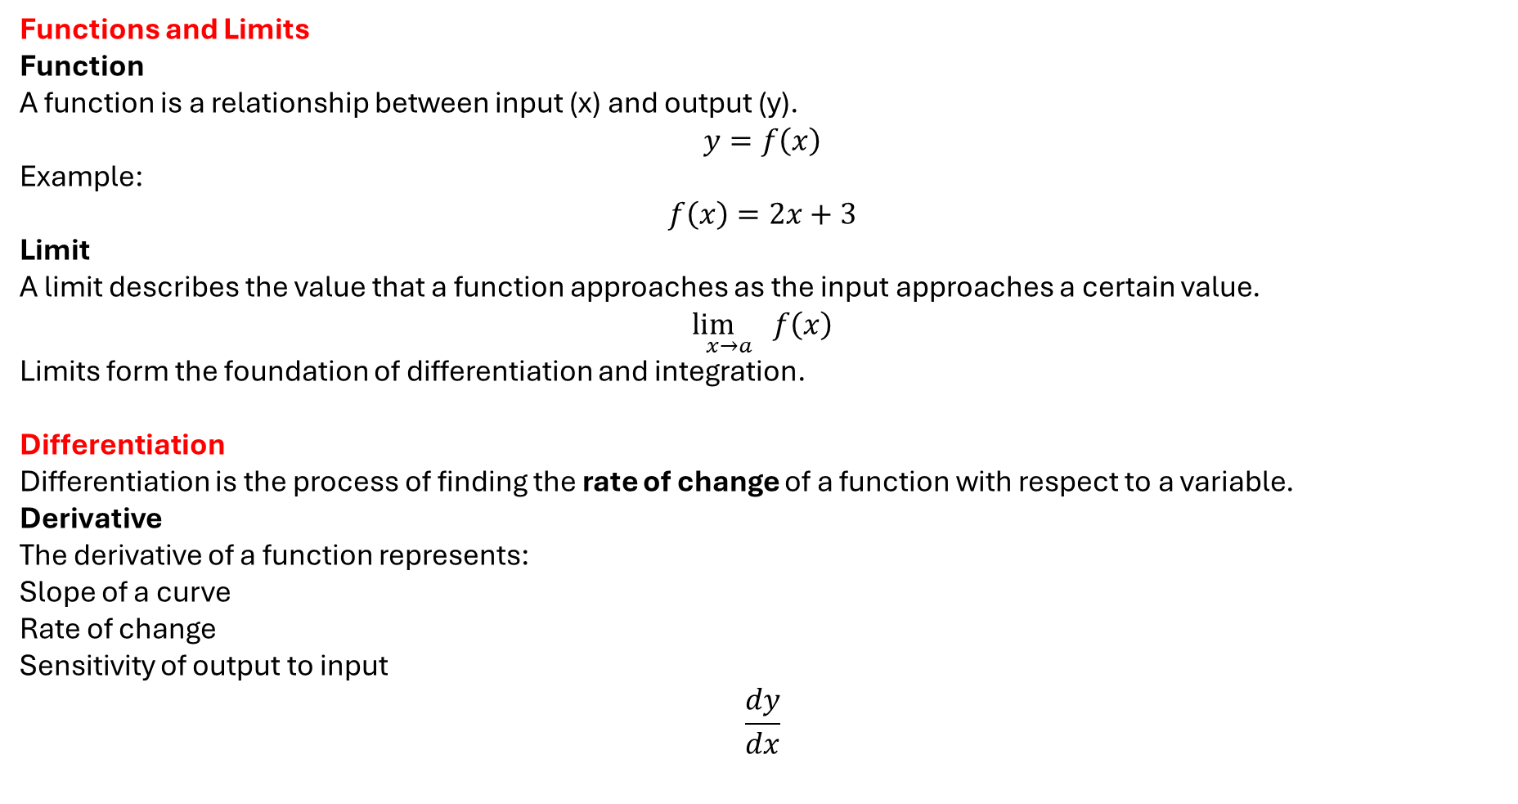
Functions and Limits
Function
A function is a relationship between input (x) and output (y).
$$y=f\left(x\right)$$
Example: $$f\left(x\right)=2x+3$$
Limit
A limit describes the value that a function approaches as the input approaches a certain value.
$$\underset{x→a}{\lim{}}f\left(x\right)$$
Limits form the foundation of differentiation and integration.
Differentiation
Differentiation is the process of finding the rate of change of a function with respect to a variable.
Derivative
The derivative of a function represents:
Slope of a curve
Rate of change
Sensitivity of output to input
$$\frac{dy}{dx}$$

Slide 4

Basic Differentiation Rules
Power Rule
$$\frac{d}{dx}\left(x^{n}\right)=nx^{n−1}$$
Constant Rule
$$\frac{d}{dx}\left(c\right)=0$$
Sum Rule
$$\frac{d}{dx}\left(f\left(x\right)+g\left(x\right)\right)=f^{′}\left(x\right)+g^{′}\left(x\right)$$
Example
If
$$f\left(x\right)=3x^{2}+5x$$
Then
$$f^{′}\left(x\right)=6x+5$$

Slide 5
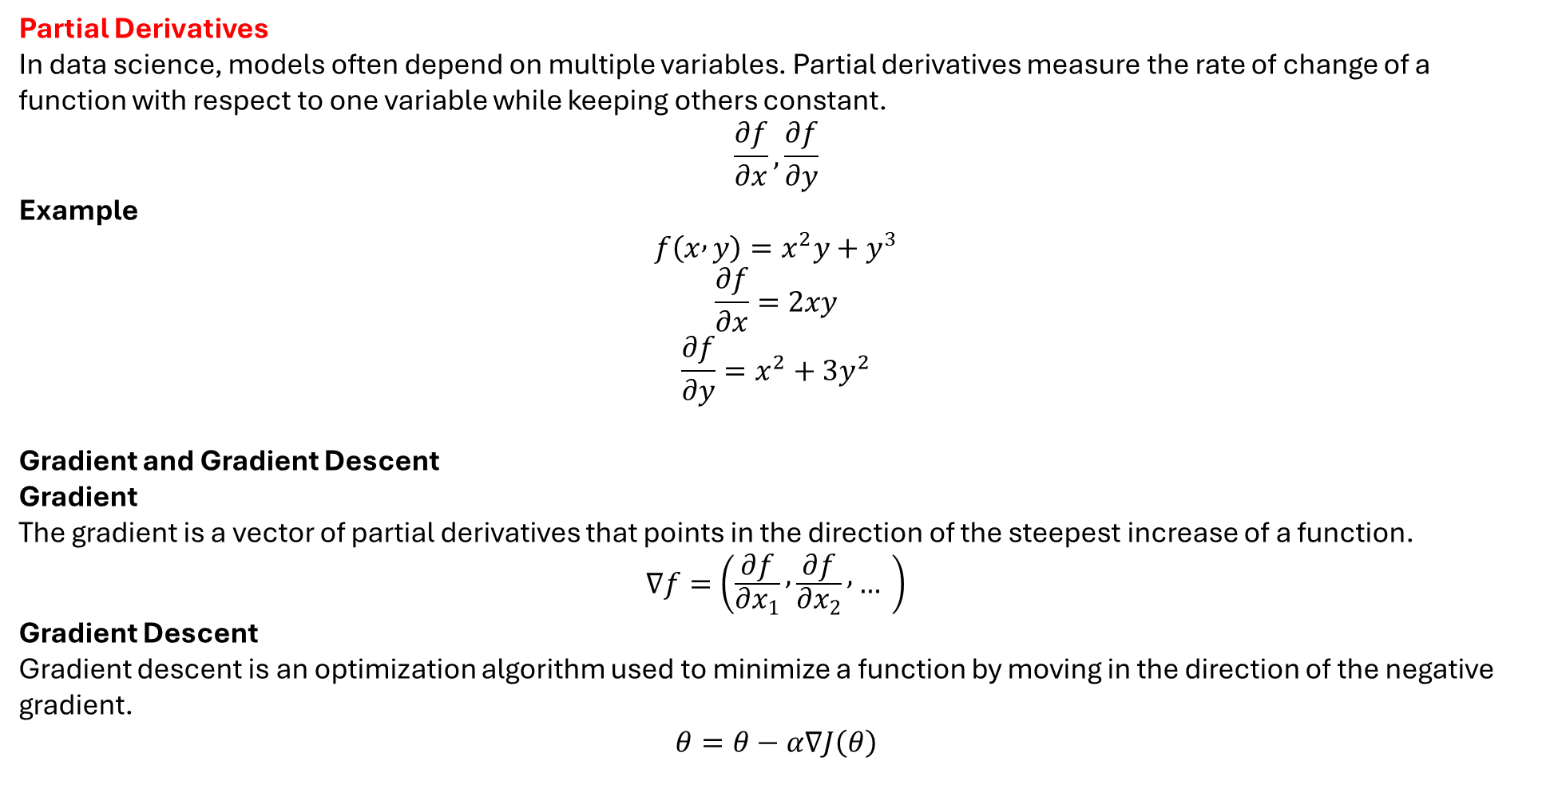
Partial Derivatives
In data science, models often depend on multiple variables. Partial derivatives measure the rate of change of a function with respect to one variable while keeping others constant.
$$\frac{∂f}{∂x}, \frac{∂f}{∂y}$$
Example
$$f\left(x , y\right)=x^{2}y+y^{3}$$
$$\frac{∂f}{∂x}=2xy$$
$$\frac{∂f}{∂y}=x^{2}+3y^{2}$$
Gradient and Gradient Descent
Gradient
The gradient is a vector of partial derivatives that points in the direction of the steepest increase of a function.
$$∇f=\left(\frac{∂f}{∂x_{1}} , \frac{∂f}{∂x_{2}} , … \right)$$
Gradient Descent
Gradient descent is an optimization algorithm used to minimize a function by moving in the direction of the negative gradient.
$$θ=θ−α∇J\left(θ\right)$$

Slide 6
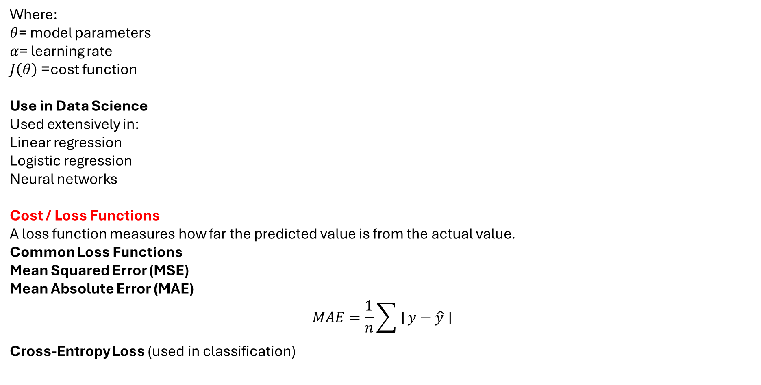
Where:
$θ$= model parameters
$α$= learning rate
$J\left(θ\right)$= cost function
Use in Data Science
Used extensively in:
Linear regression
Logistic regression
Neural networks
Cost / Loss Functions
A loss function measures how far the predicted value is from the actual value.
Common Loss Functions
Mean Squared Error (MSE)
Mean Absolute Error (MAE)
$$MAE=\frac{1}{n}\sum{∣}y−\hat{y}∣$$
Cross-Entropy Loss (used in classification)

Slide 7
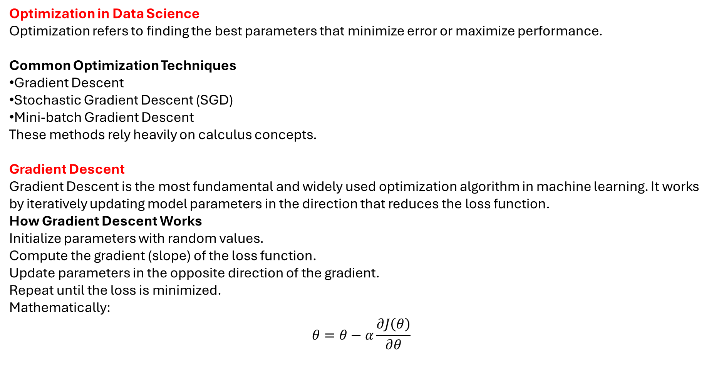
Optimization in Data Science
Optimization refers to finding the best parameters that minimize error or maximize performance.
Common Optimization Techniques
Gradient Descent
Stochastic Gradient Descent (SGD)
Mini-batch Gradient Descent
These methods rely heavily on calculus concepts.
Gradient Descent
Gradient Descent is the most fundamental and widely used optimization algorithm in machine learning. It works by iteratively updating model parameters in the direction that reduces the loss function.
How Gradient Descent Works
Initialize parameters with random values.
Compute the gradient (slope) of the loss function.
Update parameters in the opposite direction of the gradient.
Repeat until the loss is minimized.
Mathematically:
$$θ=θ−α\frac{∂J\left(θ\right)}{∂θ}$$

Slide 8
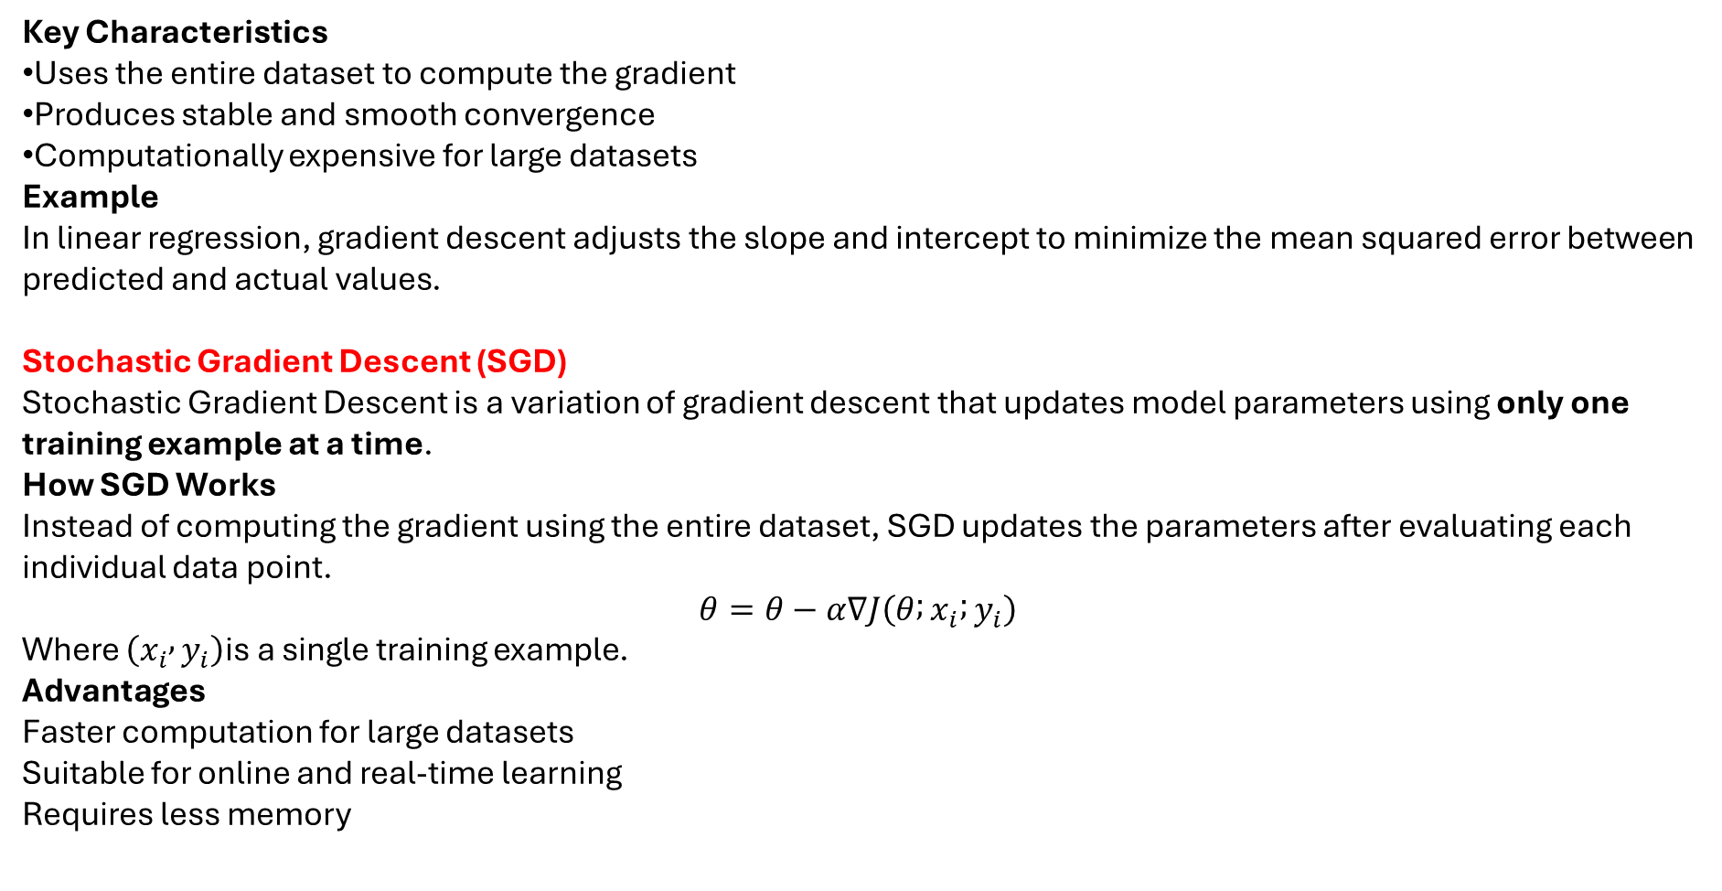
Key Characteristics
Uses the entire dataset to compute the gradient
Produces stable and smooth convergence
Computationally expensive for large datasets
Example
In linear regression, gradient descent adjusts the slope and intercept to minimize the mean squared error between predicted and actual values.
Stochastic Gradient Descent (SGD)
Stochastic Gradient Descent is a variation of gradient descent that updates model parameters using only one training example at a time.
How SGD Works
Instead of computing the gradient using the entire dataset, SGD updates the parameters after evaluating each individual data point.
$$θ=θ−α∇J\left(θ ; x_{i} ; y_{i}\right)$$
Where $\left(x_{i} , y_{i}\right)$is a single training example.
Advantages
Faster computation for large datasets
Suitable for online and real-time learning
Requires less memory

Slide 9
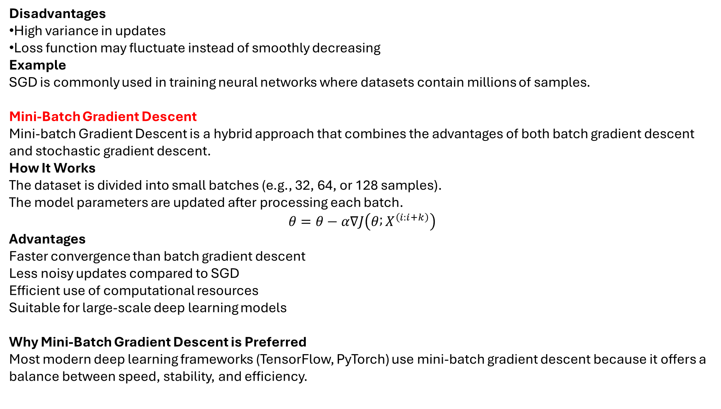
Disadvantages
High variance in updates
Loss function may fluctuate instead of smoothly decreasing
Example
SGD is commonly used in training neural networks where datasets contain millions of samples.
Mini-Batch Gradient Descent
Mini-batch Gradient Descent is a hybrid approach that combines the advantages of both batch gradient descent and stochastic gradient descent.
How It Works
The dataset is divided into small batches (e.g., 32, 64, or 128 samples).
The model parameters are updated after processing each batch.
$$θ=θ−α∇J\left(θ ; X^{\left(i:i+k\right)}\right)$$
Advantages
Faster convergence than batch gradient descent
Less noisy updates compared to SGD
Efficient use of computational resources
Suitable for large-scale deep learning models
Why Mini-Batch Gradient Descent is Preferred
Most modern deep learning frameworks (TensorFlow, PyTorch) use mini-batch gradient descent because it offers a balance between speed, stability, and efficiency.

Slide 10
Comparison of Optimization Techniques
Feature | Gradient Descent | Stochastic GD | Mini-batch GD
Data Used | Entire dataset | Single data point | Small batch
Speed | Slow | Fast | Balanced
Stability | Very stable | Noisy | Moderately stable
Memory Usage | High | Low | Moderate
Common Usage | Small datasets | Online learning | Deep learning
Optimization is the backbone of data science and machine learning. Techniques like Gradient Descent, Stochastic Gradient Descent, and Mini-batch Gradient Descent enable models to learn from data efficiently by minimizing errors. Understanding how these optimization algorithms work helps data scientists build accurate, scalable, and reliable predictive models. Proper selection of optimization techniques directly impacts model performance, training time, and accuracy.

Slide 11
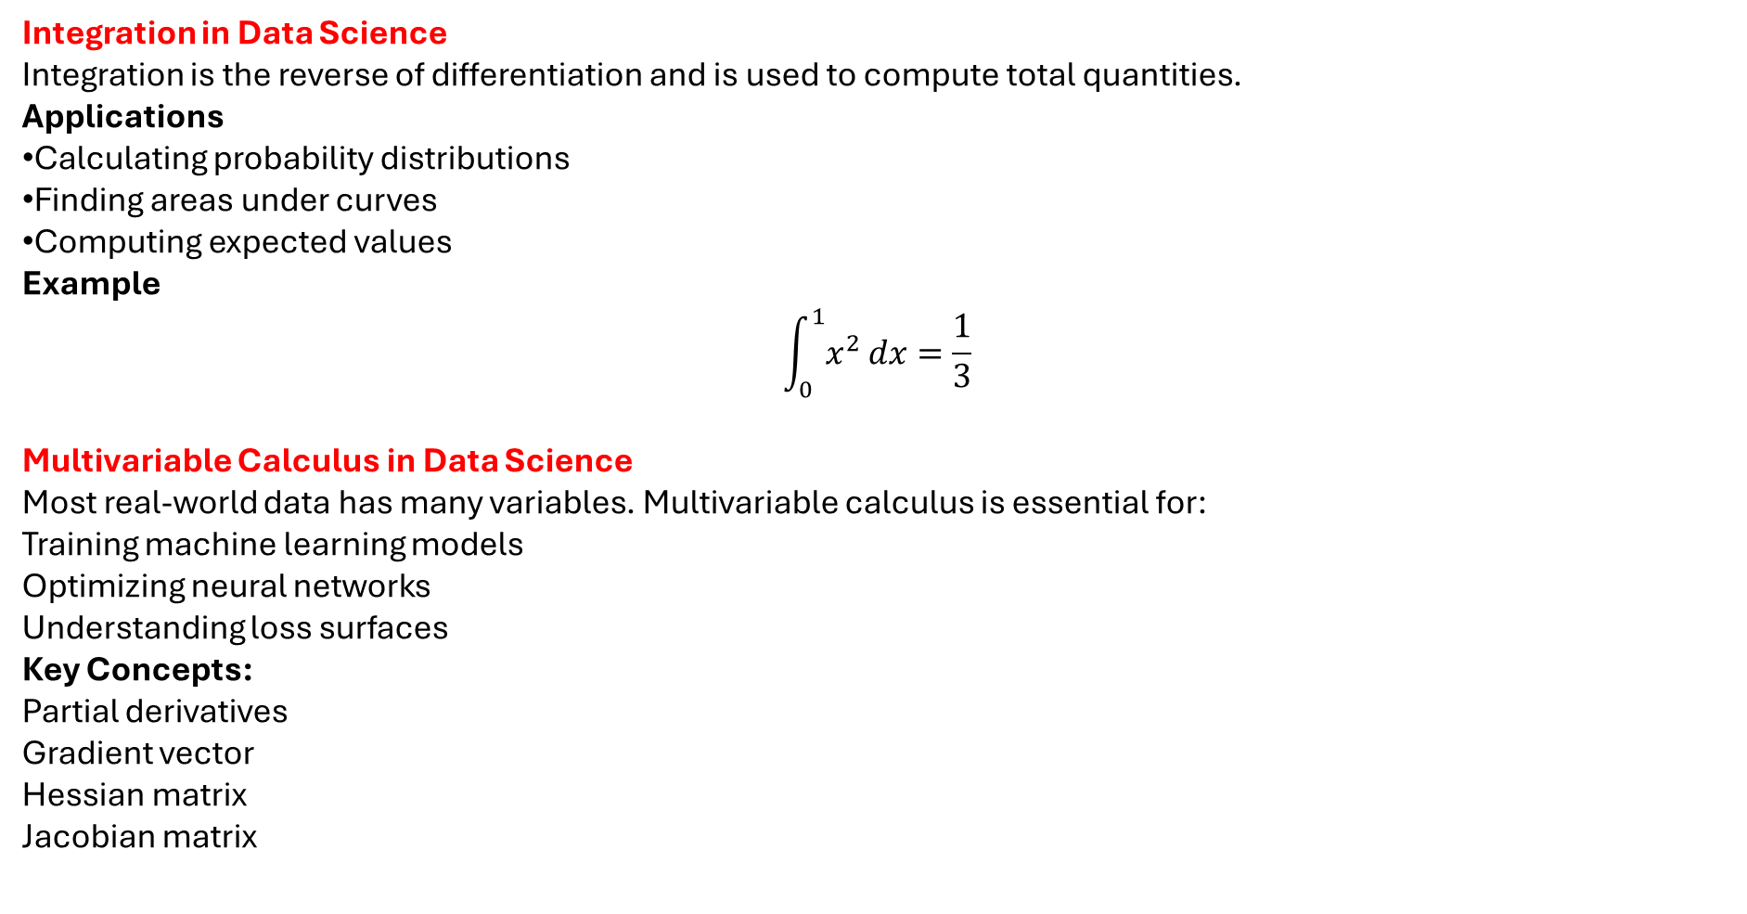
Integration in Data Science
Integration is the reverse of differentiation and is used to compute total quantities.
Applications
Calculating probability distributions
Finding areas under curves
Computing expected values
Example
$$\int_{0}^{1}{x^{2}}dx=\frac{1}{3}$$
Multivariable Calculus in Data Science
Most real-world data has many variables. Multivariable calculus is essential for:
Training machine learning models
Optimizing neural networks
Understanding loss surfaces
Key Concepts:
Partial derivatives
Gradient vector
Hessian matrix
Jacobian matrix

Slide 12
Role of Calculus in Machine Learning
Area | Use of Calculus
Linear Regression | Optimization of loss function
Logistic Regression | Gradient descent
Neural Networks | Backpropagation
Deep Learning | Weight updates using gradients
Optimization | Finding minima and maxima
Calculus forms the mathematical backbone of data science and machine learning. Concepts such as differentiation, gradients, and optimization allow machines to learn from data. Without calculus, modern algorithms like neural networks, regression models, and optimization techniques would not exist. A strong understanding of calculus enables data scientists to build accurate, efficient, and interpretable models.

